Slide 1
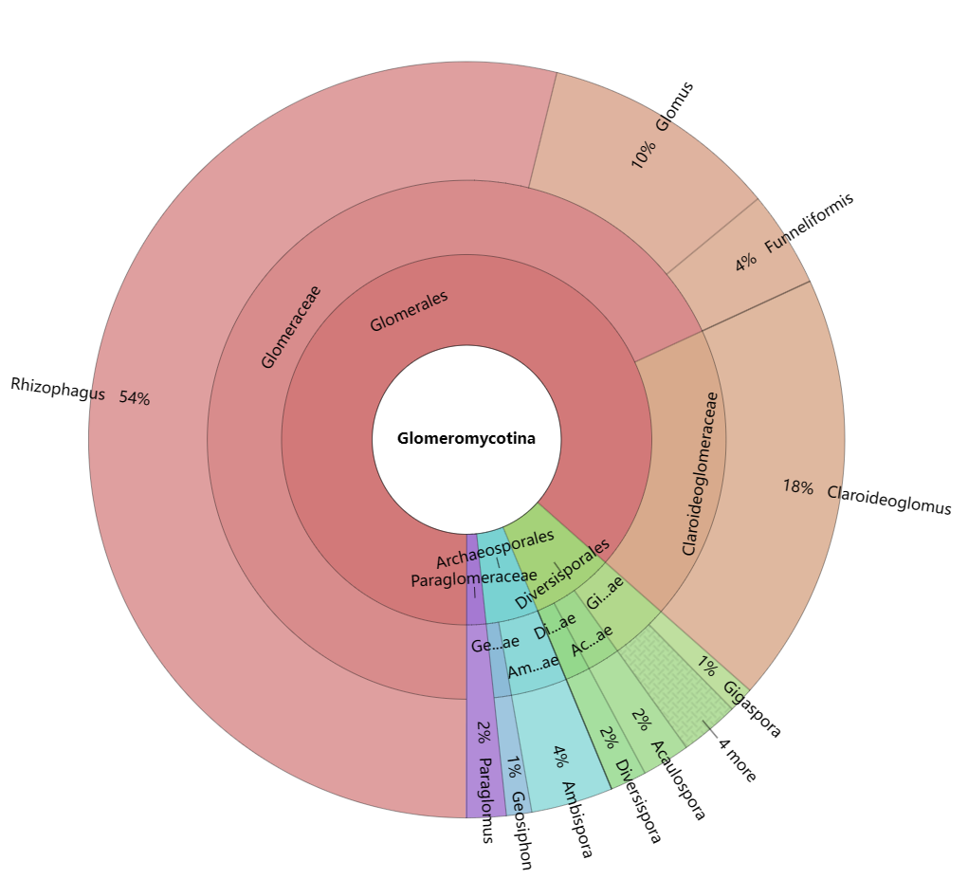
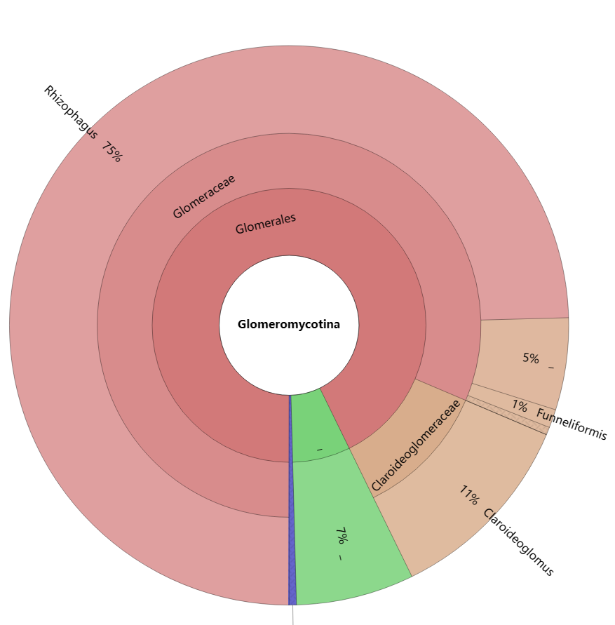
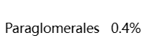
a
b
AM fungal-transcript composition
AM fungal-OTUs composition
Glomeromycotina
RNA-seq
Glomeromycotina
DNA-amplicon

